Slide 1






Saphhire Bank
Agent

Slide 2



The Ask where we started

Slide 3

Agenda
Objective of the Training
Framework for 8 Weeks
Overview
Our Journey
Tools Used
Problem definition
Challenges
Scope and conclusion
Our Team
Demo

Slide 4

Objective of the Training
Become a Full Stack web developer by gaining all the skills required to work with front-end and back-end web technologies

Slide 5

Framework for 8 Weeks
1
Database Concepts and SQL
Introduction to Applications
2
Object Oriented Programming
Data Structures Core Java Programming
3
Project- Banking Application
JDBC and Web Design fundamentals
4
Html, CSS,
Bootstrap, AJAX
5
Java Script, ES5, ES6, Angular7
UML Diagrams
6
Architecture, framework of angular.
JEE Architecture
40 Days- 200 Hours of Training
7
JSP Servlet
Spring REST( Core & MVC)
myBatis
8
Project Presentation

Slide 6
Overview
DBMS
Structured Query Language
Introduction , DML,DDL Concepts,Query Execution
Introduction,Data types,All the operations related to table,Query writing
OOPs
Core JAVA
Introduction,class,constructor,static keyword,this keyword,inheritance
Introduction ,loops ,Arrays Super,Abstraction,Polymorphism,Exception handling,Multithreading,Java I/O,java collection,Jdbc
HTML,CSS
Introduction of HTML and CSS,Examples of HTML and CSS

Slide 7
Java script
Angular7
History, Introduction, Environmental setup, Architecture of Angular, Installation using Angular CLI, Components, Modules, Data Binding, Event Binding, Directives, Pipes, Routing, Services, Testing and building Angular Project.
History, Introduction, Types of Java Script,
Components of JS, Introduction of Typescript,
ES5 and ES6
Jsp and Servlet
Spring Rest
Introduction, Environmental Setup,
Architecture, Lifecycle,
Container(Apache Tomcat),
Inbuilt services, API
Introduction, Spring framework, Environmental setup in eclipse Mars, Architecture, Containers, Configurations, Annotations, Components of Spring Application

Slide 8
Agile Methodology
Tomcat
History , introduction ,About scrum , scrum artifacts
History and introduction to tomcat
GitHub
Maven
Introduction ,Account creation, push and pull of code in the GitHub
Introduction to maven , lifecycle and phases of maven , plugin and goals
Jenkins
Introduction to Jenkins,Lifecycle and phases of DevOps

Slide 9

Our Journey

Slide 10
Sapphire Bank
Project-Banking Application
Low Level Diagrams- Use Case , Class, Application Flow.
Data Base Schema Design
Architecture of Banking Application.
UI Structure using Angular7( HTML/CSS/JS).
Backend Structure using JAVA, Spring Rest, Database.

Slide 11
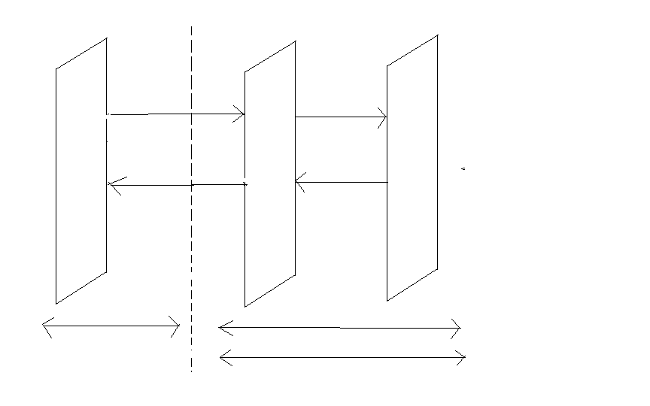
Full Stack Architecture
Angular7
HTML/CSS/JS
Java/Spring
iBatis/Hibernate
Xml HTTP Request
Browser
ORM/Database
DB
UI/UX
BC(Spring Boot)
Xml HTTP Request
Node JS
REST API
Node JS
Tomcat /Jetty
Front End Development

Slide 12







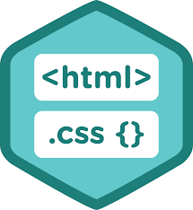



BACKEND
DevOps
DATA
FRONTEND

Slide 13
Sapphire Bank Management Application
Sapphire Bank Application allows us to perform various banking related operations like transaction,updation etc.
Agent can Approve the customer , delete the customer, view customers of particular branch and view transactions.

Slide 14
Problem Definition
To handle the customer transaction ,view transactions of the customer , Approve customer account and activate and deactivate customer accounts

Slide 15


Slide 16
Overview of Bank Management Application
These are the various job positions within Bank System. The positions are as follows:
Superuser
Admin
Agent
Customer

Slide 17
Scope and Conclusion
Scope
This project can be implemented in any bank for fulfilling the basic need
Conclusion
This bank management application will allow the customers to create the account,delete the account and manage all his transactions and it also allows the admin and agent to examine the transaction going inside bank without manual processing.

Slide 18
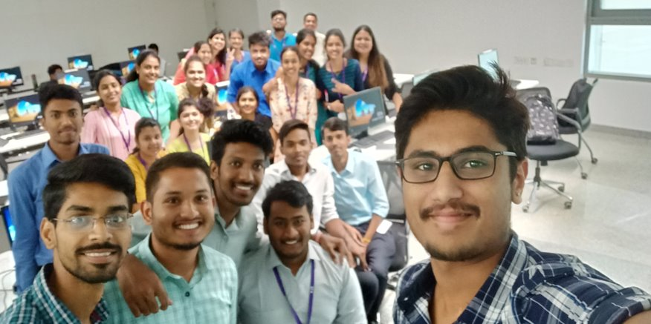
Our Team

Slide 19



Team Sapphire
Trainers
Upasana
Amit Balyan
Kavita

Slide 20

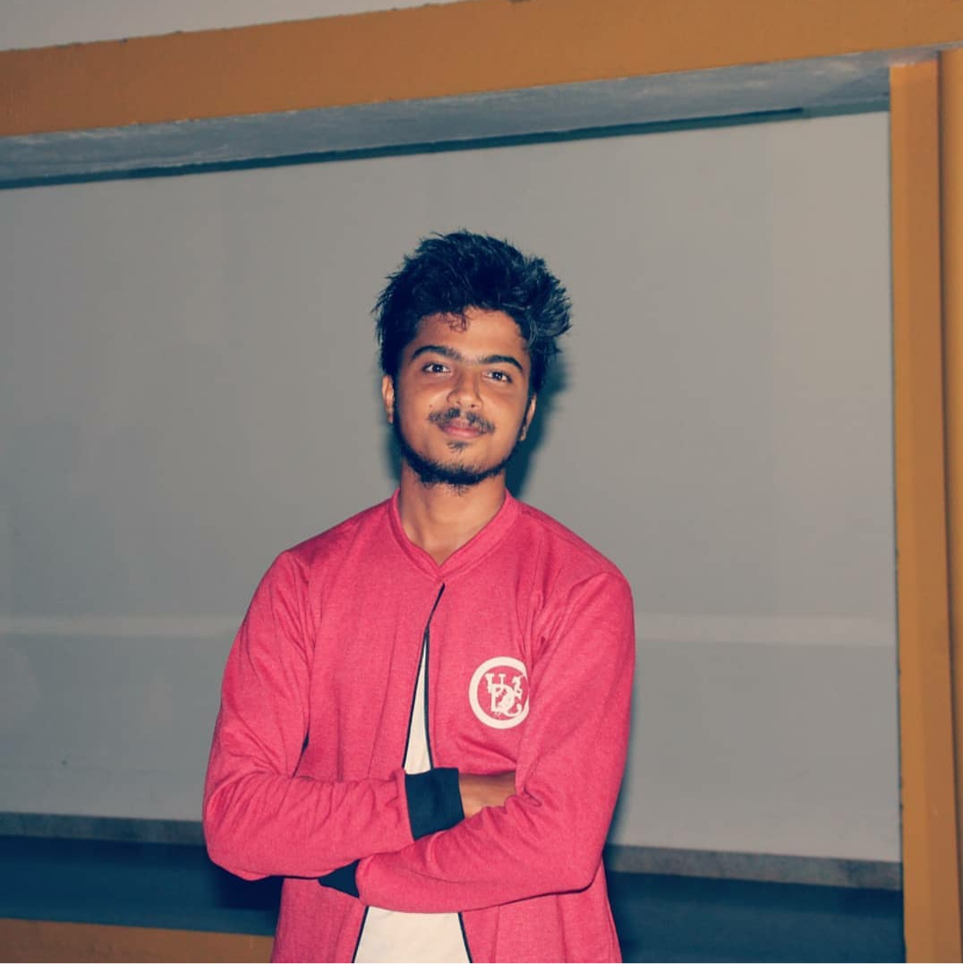
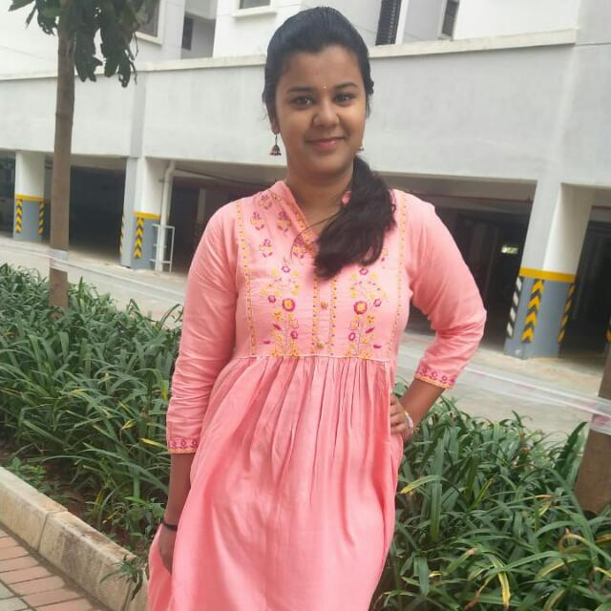


Meet Our Saphhire Team
Rachana Bhandary
Shravan Kini
Soumya Jakati
Nikitha Shetty
Vikas B

Slide 21
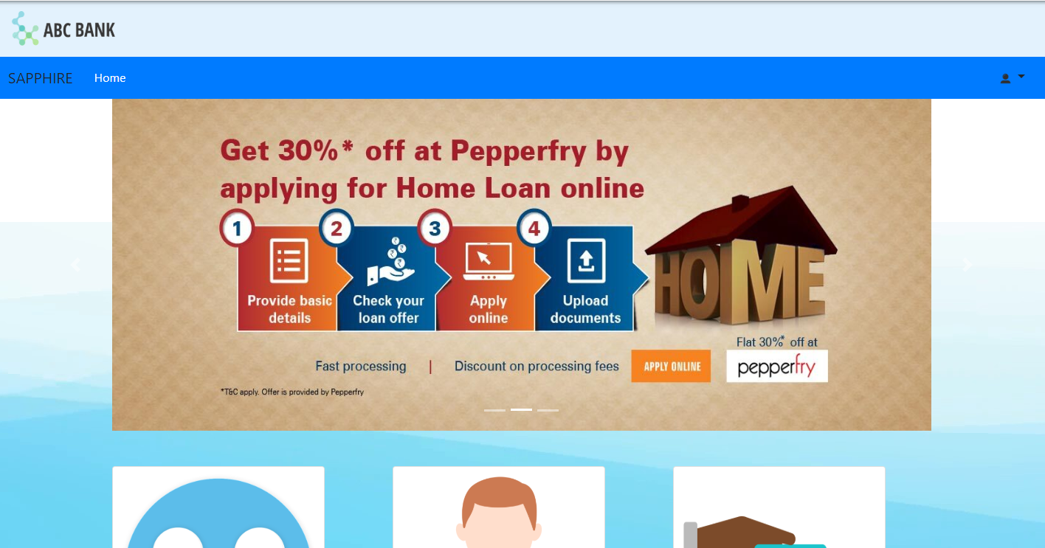
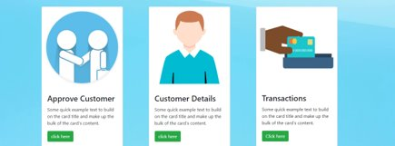
Agent Page Screenshot

Slide 22


